Slide 1

CleanSweep
On-Demand Home Cleaning
By Kushal | BTech CSE 2025–29 | ITM Skills University

Slide 2
Index
1
Problem Statement
School of
Future Tech
2
Our Solution
3
Working & Method
Case Study Presentation
4
Conclusion
Note: Content slides limited to 4 as per guidelines

Slide 3

01 | Problem Statement
The Problem
₹1,400 Cr
India home services market (2024)
Urban households need professional cleaners — but booking is broken:
• No transparent, real-time pricing
• No task-level customisation
• Poor trust signals (no background checks)
• Cluttered, non-mobile-friendly interfaces
• High checkout abandonment rates
68%
Users abandon bookings mid-flow
3x
Growth in urban cleaning demand

Slide 4

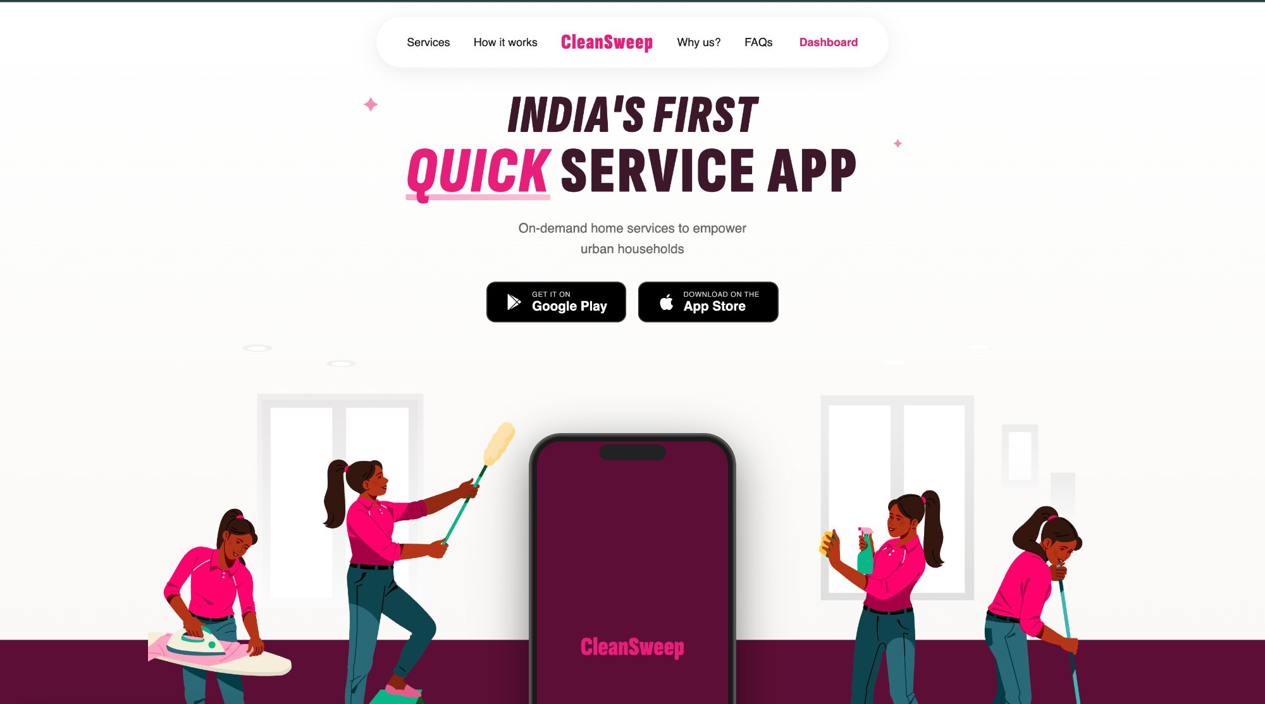




02 | Our Solution
India's First Quick Service App
Service
Browsing
Task
Checklist
Price
Estimator
Checkout
Flow
5 cleaning categories with illustrated service cards
Select specific tasks & durations; cart updates live
Real-time cost calc with square footage & discounts
sessionStorage-powered seamless booking confirmation

Slide 5

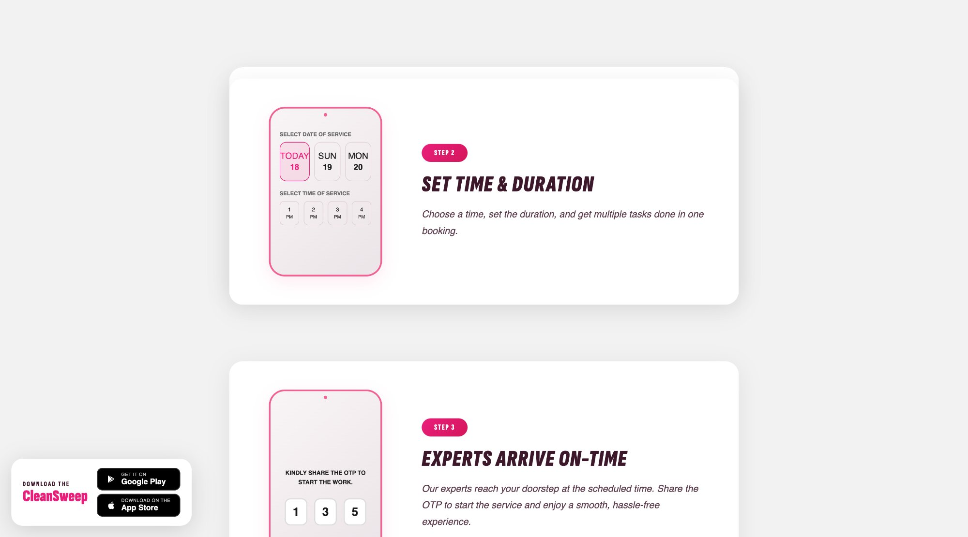
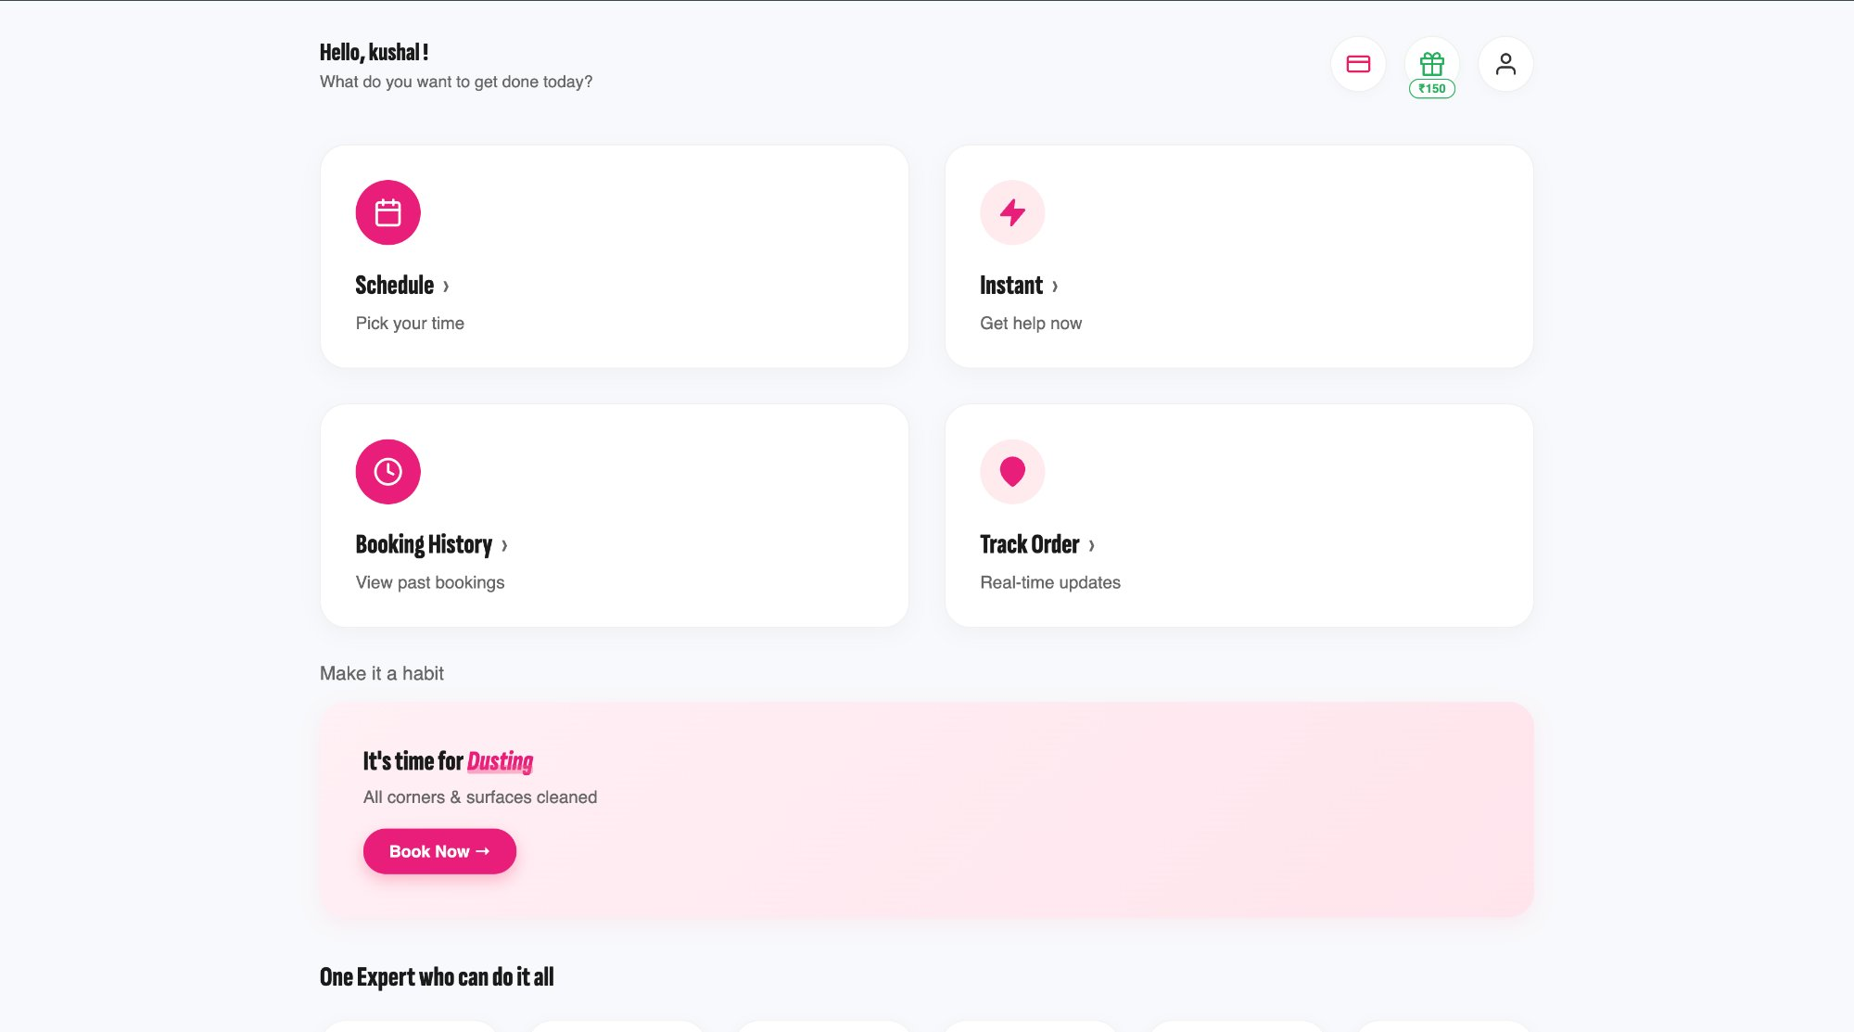
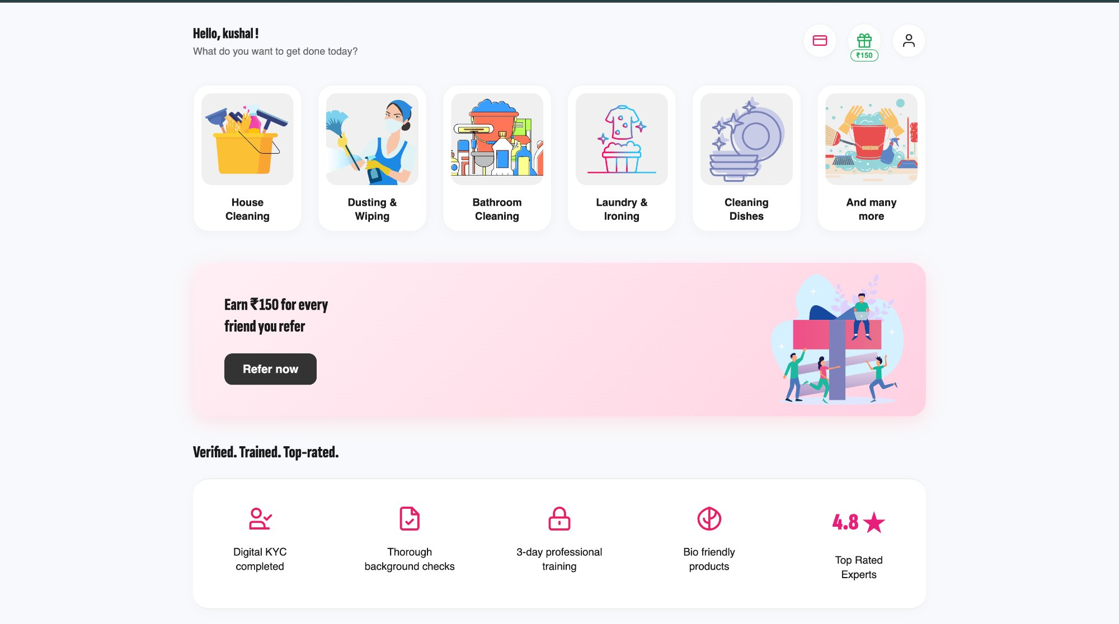
03 | Working & Method
HTML5
Semantic structure, sessionStorage
CSS3
Homepage
How It Works
Flexbox, Grid, custom variables
Vanilla JS
Cart state, DOM, price estimator
Price = Hourly Rate × Duration × Sq.Ft. Modifier
Dashboard
Services

Slide 6
04 | Conclusion
1
Vanilla Stack Works
2
CSS Variables
3
Reactive UI
Full production-quality UI built without any framework
Design token system kept code DRY and themeable
Real-time price estimator with no React or Vue
CleanSweep proves that thoughtful frontend engineering — clean HTML, modular CSS, and vanilla JS — can ship a polished, user-centred product without any framework.

Slide 7
Thank You
github.com/kushal-sw/clean-sweep

